Slide 1
Sparse Matrices
Prof. Manmath N. Sahoo

Slide 2
Sparse Matrices
sparse … many elements are zero
dense … few elements are zero

Slide 3
Example Of Sparse Matrices
  diagonal
  tridiagonal
  lower triangular
  upper triangular
These are structured sparse matrices.

Slide 4
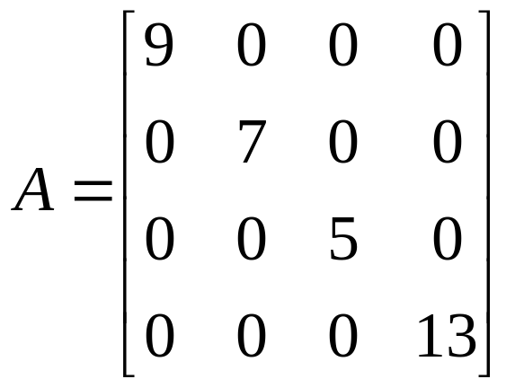
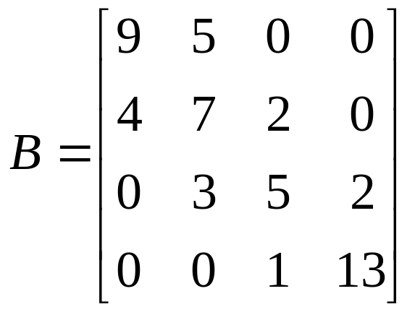
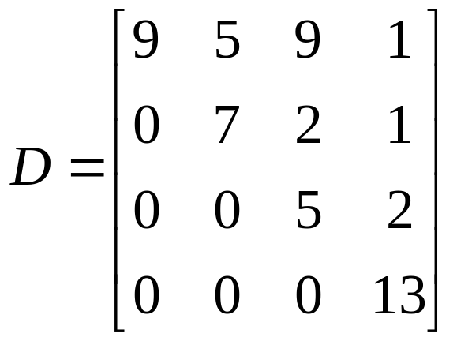
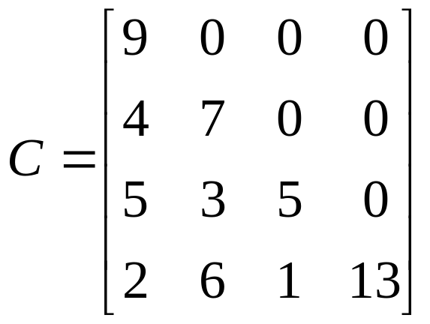
Diagonal matrix
Tri-diagonal matrix
Lower triangular matrix
Upper triangular matrix

Slide 5
Unstructured Sparse Matrices
Airline flight matrix.
  airports are numbered 1 through n
  flight(i,j) = no of nonstop flights from airport i to airport j
  n = 1000 (say)
  n x n array of list references => 2 million bytes
  total number of flights = 20,000 (say)
  need at most 20,000 references => at most 40,000 bytes
Notes:
Assume that flight(i,j) = null if there is no flight from i to j. Of the 1 million entries in the flight matrix at most 20,000 can be nonnull as each nonnull entry represents at least 1 different flight. So we need to store at most 20,000 nonnull entries.

Slide 6
Unstructured Sparse Matrices
Web page matrix.
  web pages are numbered 1 through n
  web(i,j) = number of links from page i to page j
Notes:
Web page analyses are done using a matrix such as web(*,*). See IEEE Computer, August 1999, p 60, for a paper that describes Web analysis based on such a matrix. Operations such as matrix transpose and multiply are used.

Slide 7
Web Page Matrix
  n = 2 billion (and growing by 1 million a day)
  n x n array of ints => 8 * 10¹⁸ bytes (≈ 8 * 10⁹ GB)
  each page links to 10 (say) other pages on average
  on average there are 10 nonzero entries per row
  space needed for nonzero elements is approximately 20 billion x 2 bytes = 40 billion bytes (40 GB)
Notes:
On average, 10 entries in each row are nonzero.

Slide 8
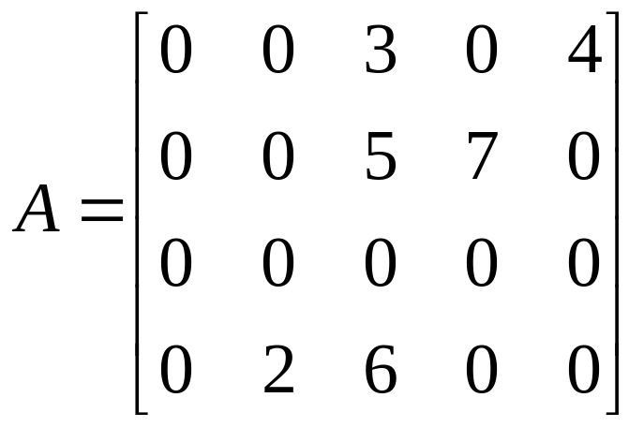
Representation Of Unstructured Sparse Matrices using triplet array
4 | 5 | 6
1 | 3 | 3
1 | 5 | 4
2 | 3 | 5
2 | 4 | 7
4 | 2 | 2
4 | 3 | 6
(row, column, value) --- triplet

Slide 9
Chain Representation
Node structure.
row
col
value
next
Notes:
The drawing, above, assumes a custom class for matrices. This custom class does not use the class Chain.
If you want to use the class Chain, the fields row, col, and value need to be in another
class, say Data. The elements of Chain will have the data type Data.

Slide 10
Single Chain
1
3
1
5
2
3
2
4
4
2
4
3
3
4
5
7
2
6
null
firstNode

Slide 11
One Linear List Per Row
row1 = [(3, 3), (5,4)]
row2 = [(3,5), (4,7)]
row3 = []
row4 = [(2,2), (3,6)]
Notes:
Array linear list per row.

Slide 12
Array Of Row Chains
Node structure.
next
col
value
Notes:
The above drawing assumes a custom class for sparse matrices. If you want to use the class Chain, the col and value fields will be members of some other class (say) Data. The data type of the elements in the chains will be Data.

Slide 13
Array Of Row Chains
null
0 0 3 0 4
0 0 5 7 0
0 0 0 0 0
0 2 6 0 0
3
3
5
4
null
3
5
4
7
null
null
2
2
3
6
*row[]
Notes:
When using the class Chain for each row chain, the array row is declared as
Chain [] row = new Chain[numberOfRows];
After row[i] is initialized by calling the constructor for Chain, row[i].firstNode gets you to the first node in the chain for row i.
Book has a chain of row chains. In this case only non-empty row chains are present.

Slide 14
One Linear List Per Column
col1 = []
col2 = [(4,2)]
col3 = [(1, 3), (2,5), (4,6)]
col4 = [(2,7)]
col5 = [(1,4)]
Notes:
Array linear list per row.

Slide 15
Array Of Column Chains
Node structure.
next
row
value
down
Notes:
The above drawing assumes a custom class for sparse matrices. If you want to use the class Chain, the col and value fields will be members of some other class (say) Data. The data type of the elements in the chains will be Data.

Slide 16
Array Of Column Chains
0 0 3 0 4
0 0 5 7 0
0 0 0 0 0
0 2 6 0 0
*col[]
null
1
3
1
4
n
2
7
2
5
n
4
2
4
6
n
n

Slide 17
Orthogonal List Representation
Both row and column lists.
Node structure.
row
col
value
down
next

Slide 18
Row Lists
0 0 3 0 4
0 0 5 7 0
0 0 0 0 0
0 2 6 0 0
3
3
5
4
n
3
5
4
7
n
null
2
2
3
6
n

Slide 19
Column Lists
0 0 3 0 4
0 0 5 7 0
0 0 0 0 0
0 2 6 0 0
null
1
3
1
4
n
2
5
2
7
4
2
4
6
n
n

Slide 20
Orthogonal Lists
0 0 3 0 4
0 0 5 7 0
0 0 0 0 0
0 2 6 0 0
null
1
3
1
3
5
4
n
n
2
3
2
5
4
7
n
null
4
2
4
2
3
6
n
n
n
row[]

Slide 21
Storage Requirements
500 x 500 integer matrix with 1994 nonzero elements
2D array 500 x 500 x 2 = 0.5million bytes
Triplet array 3 x 1994 x 2 = 11,964 bytes
(without header)
Linked list 1994 x 8 (node size) + 2 (head) = 15954 bytes
One Chain Per Row 1994 x 6 (node size) + 2 x 500
= 12,964 bytes
Orthogonal List---- how many bytes?

